Slide 1
CANDLE app
PROJECT ADVISORS:
-DR/MOHAMED ATTA KHAFAGY
-DR/SAFYNAZ ABDELFATTAH
BY:
-MUHAMMAD REFAAY ALALLAMY
-ABDELRHMAN AHMED ALI
-AHMED MOHAMMED HASSAAN
-MAHMOUD RAGAB HEZAYEN
-TAHA MAHMOUD FARG

Slide 2
INTRO
Our project derives its importance from the importance of reading, but what is the importance of reading?
Reading has always instilled ideas in the heads of creative people and developed into new inventions.
We will show some examples that will explain the importance of reading and thus the importance of our idea

Slide 3
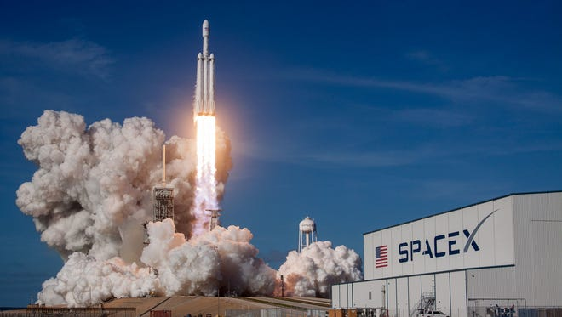
Falcon rocket
When a Falcon rocket blasted into space in February 2018, it was carrying an unexpected payload. Unlike the red "Tesla Roadstar" car and the doll in the astronaut suit behind the steering wheel, SpaceX founder Elon Musk put in the front glove box of the car the "foundation" series of novels by Isaac Asimov recorded on an optical disk. Its events took place in a future era after nearly 50,000 years, igniting his passion for space travel as a teenager

Slide 4
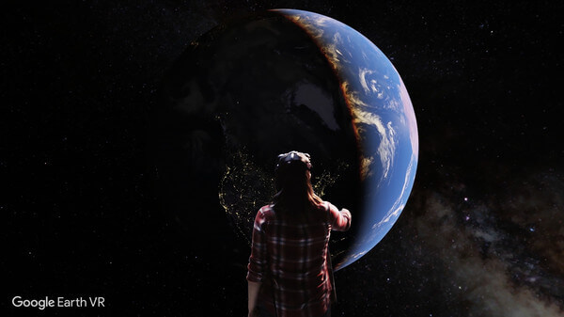
Google Earth
"Earth" program in Neil Stephenson's novel "The Avalanche“ , from which the "Google Earth" application was inspired

Slide 5

World Wide Web
phones that have the ability to sense in Arthur C. Clarks' novel , which She led Tim Berners-Lee to invent the World Wide Web

Slide 6
what is the relationship of all this to our project?
Our project aims to launch many services that facilitate the task of reading, and we can mention, for example, the word cloud, the mind map, and the summary of texts. All these services will help attract many readers and help them to reach the purpose of every article, report or scientific content that they read easily and Without effort, our project will help many creative people to continue achievements, change the concept of reading for some, and continue working until reading becomes an enjoyable activity.

Slide 7
Word cloud
Automatically generating Word cloud A word cloud is a collection or cluster, of words depicted in different sizes. The bigger and bolder the word appears, the more often it’s mentioned within a given text and the more important it is.
This is an excellent first step, as our brains prefer visual information over any other format.
It is a great icebreaker acts as a perfect way to kick start reading your file.
We can watch a practical example to see the importance and way of representing the word cloud , so lets see

Slide 8
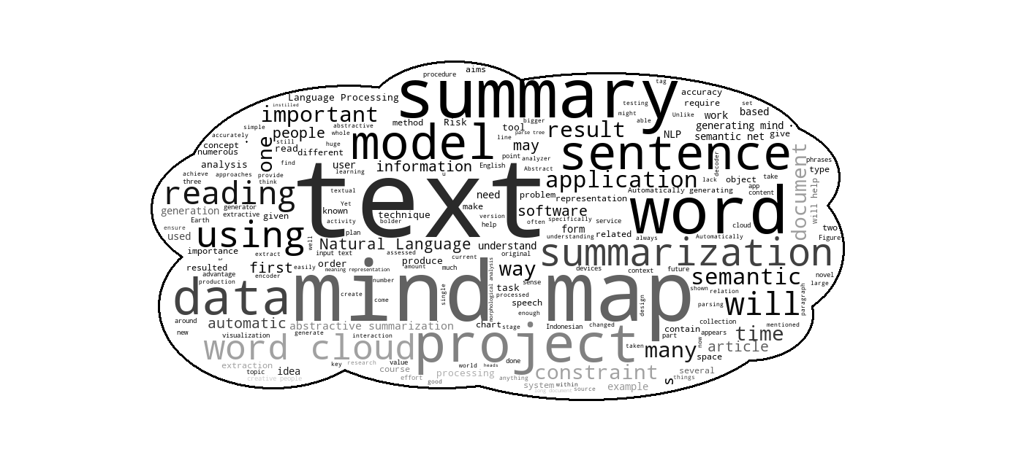
Note: this is a word cloud for our document

Slide 9
Mind map
Mind mapping is a popular brainstorming tool and thinking technique of visually arranging ideas and their interconnections Automatically generating mind maps out of pure text and that requires many stages of text processing .
there is applications for drawing Mind map but are manual, because the user manually determines the mind map element These softwares help the user in drawing the mind map and have some ready designs and diagrams which can be used. But the user must read, understand the text well and come up with a design for the mind map himself.
We provide Automatically generating mind maps out of pure text and that requires many stages of text processing.

Slide 10
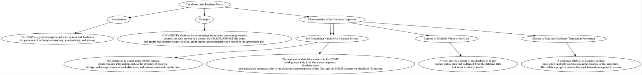
Note : Mind Map from our App

Slide 11
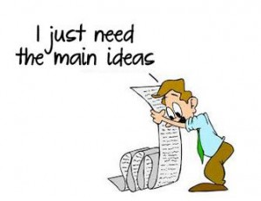
summary
summary is a shortened version of a text. It contains the main points in the text.
Automatically generating summary.

Slide 12
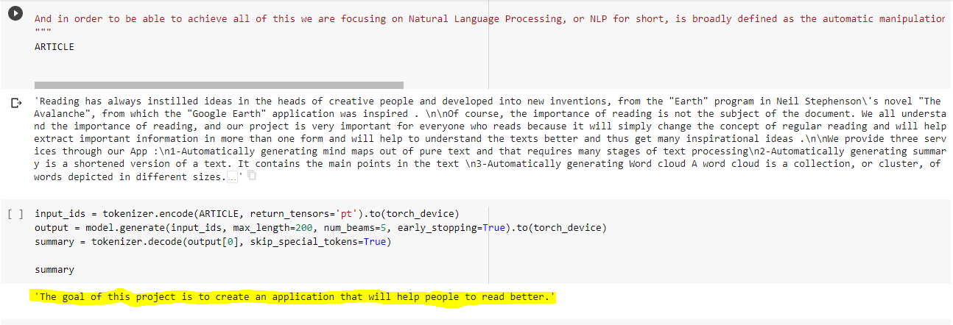
Note : summary for our Abstract

Slide 13
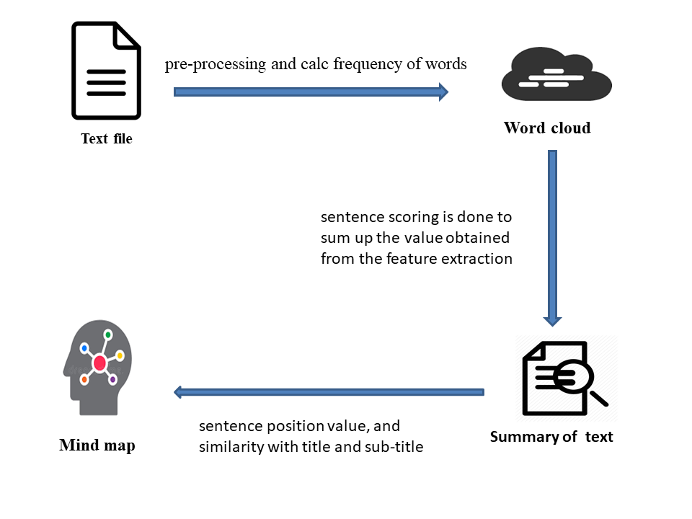
Graphical Abstract

Slide 14
